Slide 1
RAU Operating Systems 2015
Lab #5

Slide 2
Thread synchronization Basics #1
Thread synchronization is used to prevent corruption when multiple threads access shared data at the same time.
Execution model
Simple
Multiple CPUs or multiple threads
In general the programmer has no control over when each thread runs; the operating system (speciﬁcally, the scheduler) makes those decisions.
Real-world example: Imagine that you and your friend Bob live in diﬀerent cities, and one day, around dinner time, you start to wonder who ate lunch ﬁrst that day, you or Bob. How would you ﬁnd out?

Slide 3
Thread synchronization Basics #2
Message passing solution
You
a1 Eat breakfast
a2 Work
a3 Eat lunch
a4 Call Bob
Bob
b1 Eat breakfast
b2 Wait for a call
b3 Eat lunch
a1 < a2 < a3 < a4 b1 < b2 < b3
Is a1 < b1?
We can tell who ate lunch ﬁrst (a3 < b3). Assuming that Bob won’t get a call until you call, so b2 > a4. Combining all the relations, we get b3 > b2 > a4 > a3
In this case, we would say that you and Bob ate lunch sequentially, because we know the order of events, and you ate breakfast concurrently, because we don’t.
Two events are concurrent if we cannot tell by looking at the program which will happen ﬁrst.

Slide 4
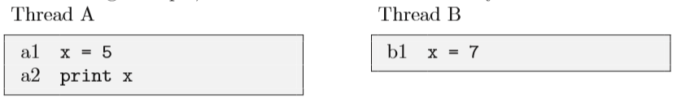

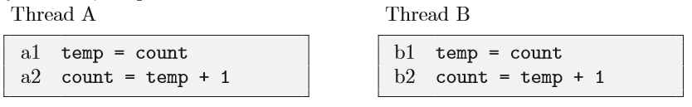
Thread synchronization Basics #3
Concurrent programs are often non-deterministic, which means it is not possible to tell, by looking at the program, what will happen when it executes.
Some variables are shared among two or more threads; this is one of the ways threads interact with each other. For example, one way to communicate information between threads is for one thread to read a value written by another thread.
Concurrent writes
Concurrent updates
Notes:
Puzzle: What path yields output 5 and ﬁnal value 5? Puzzle: What path yields output 7 and ﬁnal value 7? Puzzle: Is there a path that yields output 7 and ﬁnal value 5? Can you prove it?

Slide 5
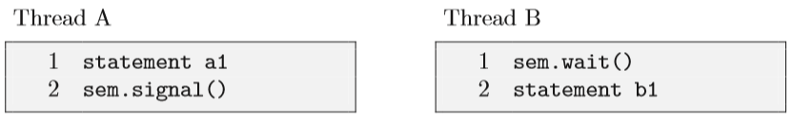
Semaphores
A semaphore is like an integer, with three diﬀerences:
1. When you create the semaphore, you can initialize its value to any integer, but after that the only operations you are allowed to perform are increment (increase by one) and decrement (decrease by one). You cannot read the current value of the semaphore.
2. When a thread decrements the semaphore, if the result is negative, the thread blocks itself and cannot continue until another thread increments the semaphore.
3. When a thread increments the semaphore, if there are other threads waiting, one of the waiting threads gets unblocked.

Slide 6
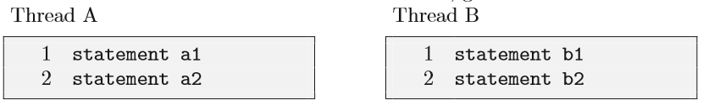
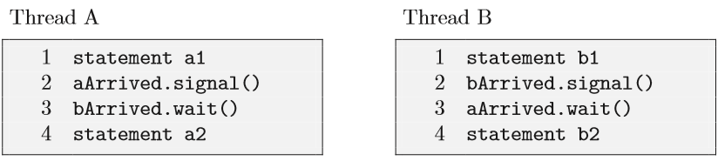
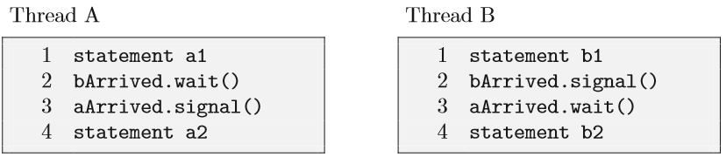
Rendezvous problem
We want to guarantee that a1 happens before b2 and b1 happens before a2.
Notes:
2-nd solution is not as good as the first one. Why?
Make a deadlock. Describe your solution.

Slide 7

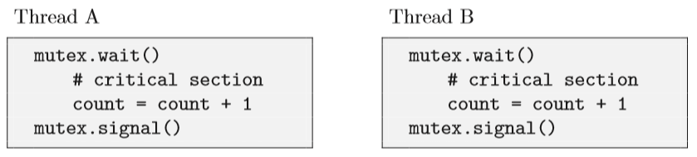
Mutex
Puzzle: Add semaphores to the following example to enforce mutual exclusion to the shared variable count.

Slide 8

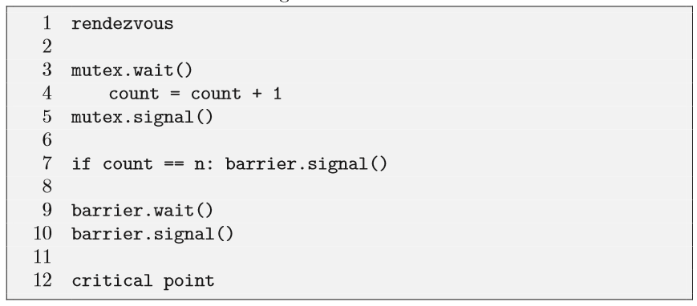
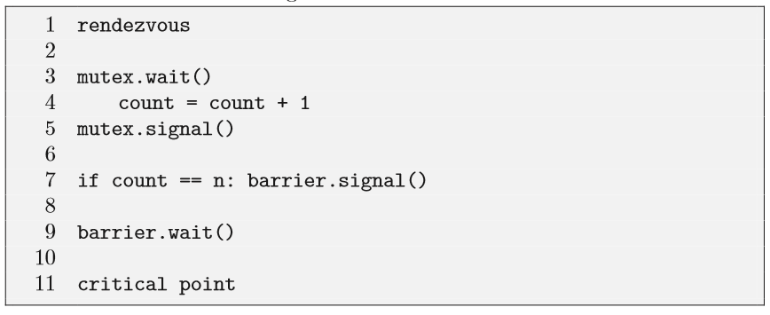
Barrier
Puzzle: Generalize the rendezvous solution. The synchronization requirement is that no thread executes critical point until after all threads have executed rendezvous. Every thread should run the following code:
Hint:
Consider using these variables:
n = the number of threads, count = 0, mutex = Semaphore(1), barrier = Semaphore(0).
count keeps track of how many threads have arrived. mutex provides exclusive access to count so that threads can increment it safely. barrier is locked (zero or negative) until all threads arrive; then it should be unlocked (1 or more).
Notes:
Consider again the Rendezvous problem. A limitation of the solution we presented is that it does not work with more than two threads.
An an example, imagine that n = 5 and that 4 threads are waiting at the barrier. The value of the semaphore is the number of threads in queue, negated, which is -4. When the 5th thread signals the barrier, one of the waiting threads is allowed to proceed, and the semaphore is incremented to -3. But then no one signals the semaphore again and none of the other threads can pass the barrier. This is a second example of a deadlock.

Slide 9
Classical synchronization problems. Producer-consumer problem
There are several synchronization constraints that we need to enforce to make this system work correctly:
While an item is being added to or removed from the buﬀer, the buﬀer is in an inconsistent state. Therefore, threads must have exclusive access to the buﬀer.
If a consumer thread arrives while the buﬀer is empty, it blocks until a producer adds a new item.
Basic consumer code
1 event = buffer.get()
2 event.process()
Puzzle: Add synchronization statements to the producer and consumer code to enforce the synchronization constraints
Basic producer:
1 event = waitForEvent()
2 buffer.add(event)
Notes:
In multithreaded programs there is often a division of labor between threads. In one common pattern, some threads are producers and some are consumers. Producers create items of some kind and add them to a data structure; consumers remove the items and process them.
Event-driven programs are a good example. An “event” is something that happens that requires the program to respond: the user presses a key or moves the mouse, a block of data arrives from the disk, a packet arrives from the network, a pending operation completes. Whenever an event occurs, a producer thread creates an event object and adds it to the event buﬀer. Concurrently, consumer threads take events out of the buﬀer and process them. In this case, the consumers are called “event handlers.”

Slide 10
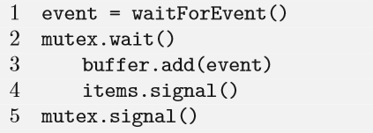
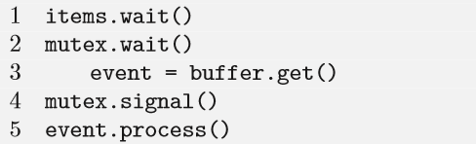
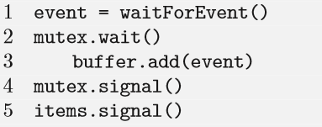
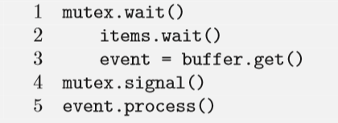
Producer-consumer problem. Solution.
Hint: mutex = Semaphore(1), items = Semaphore(0), local event
Mutex provides exclusive access to the buﬀer
When items is positive, it indicates the number of items in the buﬀer. When it is negative, it indicates the number of consumer threads in queue.
Event is a local variable, which in this context means that each thread has its own version.
Notes:
In multithreaded programs there is often a division of labor between threads. In one common pattern, some threads are producers and some are consumers. Producers create items of some kind and add them to a data structure; consumers remove the items and process them.
Event-driven programs are a good example. An “event” is something that happens that requires the program to respond: the user presses a key or moves the mouse, a block of data arrives from the disk, a packet arrives from the network, a pending operation completes. Whenever an event occurs, a producer thread creates an event object and adds it to the event buﬀer. Concurrently, consumer threads take events out of the buﬀer and process them. In this case, the consumers are called “event handlers.”
Imagine that the buﬀer is empty. A consumer arrives, gets the mutex, and then blocks on items. When the producer arrives, it blocks on mutex and the system comes to a grinding halt.

Slide 11
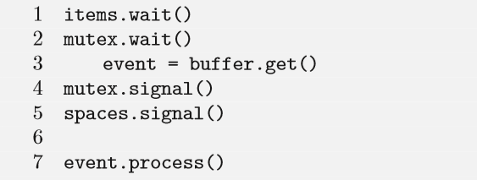
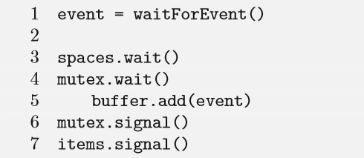
Producer-consumer problem. Solution #2.
Let’s add a new constraint: If a producer arrives when the buﬀer is full, it blocks until a consumer removes an item.
Puzzle: Rewrite previous problem for finite buffer scenario.
Hint: mutex = Semaphore(1), items = Semaphore(0), spaces = Semaphore(buffer.size())
Notes:
When a consumer removes an item it should signal spaces. When a producer arrives it should decrement spaces, at which point it might block until the next consumer signals.

Slide 12
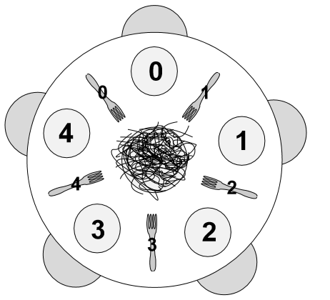
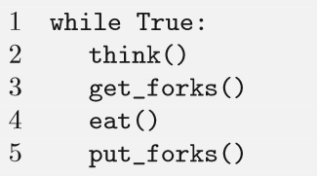
Dining philosophers
Philosopher needs two forks to eat
Philosopher i has fork i on right and form i+1 on left.
Only one philosopher can hold a fork at a time.
It must be impossible for a deadlock to occur.
It must be impossible for a philosopher to starve waiting for a fork.
It must be possible for more than one philosopher to eat at the same time.

Slide 13
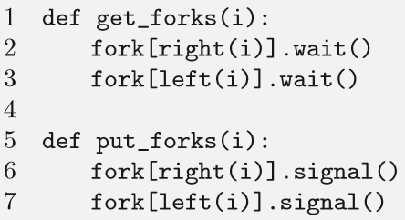
Dining philosophers
def left(i): return I
def right(i): return (i + 1) % 5
forks = [Semaphore(1) for i in range(5)]
Notes:
The problem is that the table is round. As a result, each philosopher can pick up a fork and then wait forever for the other fork. Deadlock!
Hint: one way to avoid deadlock is to think about the conditions that make deadlock possible and then change one of those conditions. In this case, the deadlock is fairly fragile—a very small change breaks it.
If only four philosophers are allowed at the table at a time, deadlock is impossible.

Slide 14
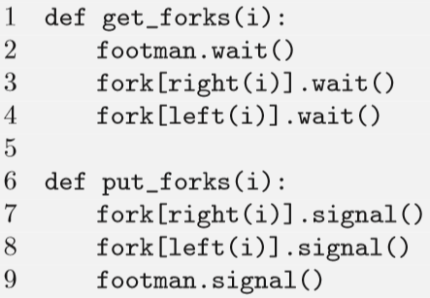
Dining philosophers
def left(i): return I
def right(i): return (i + 1) % 5
forks = [Semaphore(1) for i in range(5)]
Footman = Sempahore(4)
Notes:
Control number of philosophers to be 4.
In addition to avoiding deadlock, this solution also guarantees that no philosopher starves. Imagine that you are sitting at the table and both of your neighbors are eating. You are blocked waiting for your right fork. Eventually your right neighbor will put it down, because eat can’t run forever. Since you are the only thread waiting for that fork, you will necessarily get it next. By a similar argument, you cannot starve waiting for your left fork.

Slide 15
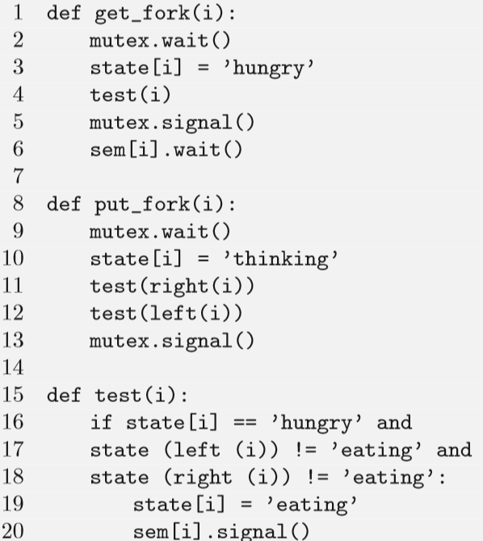
Dining philosophers. Tanenbaums Solution
state = [’thinking’] * 5 (thinking, eating, or waiting to eat (“hungry”))
sem = [Semaphore(0) for i in range(5)]
mutex = Semaphore(1)
Notes:
The test function checks whether the ith philosopher can start eating, which he can if he is hungry and neither of his neighbors are eating. If so, the test signals semaphore i.
There are two ways a philosopher gets to eat. In the ﬁrst case, the philosopher executes get forks, ﬁnds the forks available, and proceeds immediately. In the second case, one of the neighbors is eating and the philosopher blocks on its own semaphore. Eventually, one of the neighbors will ﬁnish, at which point it executes test on both of its neighbors.
No deadlock is possible, because the only semaphore that is accessed by more than one philosopher is mutex, and no thread executes wait while holding mutex.
Imagine that we are trying to starve Philosopher 0. Initially, 2 and 4 are at the table and 1 and 3 are hungry. Imagine that 2 gets up and 1 sit downs; then 4 gets up and 3 sits down. Now we are in the mirror image of the starting position. If 3 gets up and 4 sits down, and then 1 gets up and 2 sits down, we are back where we started. We could repeat the cycle indeﬁnitely and Philosopher 0 would starve.

